Slide 1

Internet Programming Two
By Girmachew Gulint
2016 E.C

Slide 2
Chapter One
Web server and installation
Server-side scripting language
Basic Syntax
Variables and constant
Comments
Send data to the Browser
Data types and casting

Slide 3
Objectives
By the end of this chapter students will be able to:
Understand what server scripting language is .
Installing and maintaining tools use to develop dynamic web site.
Manipulating data using PHP.

Slide 4
Web server and its installation
A web server, which includes both the hardware and software components, is a system that delivers web content to clients, typically web browsers, via different protocols typically Hypertext Transfer Protocol (HTTP).
The hardware aspect involves the physical server machines that host the web server software.
The software processes requests from clients, retrieves the requested web pages or resources, and sends them back to the client's browser for display.
Common web servers include Apache, Nginx, and Microsoft Internet Information Services (IIS), each of which has unique features and performance capabilities.
Apache and Nginx are open-source web servers known for their reliability and flexibility, while IIS is a proprietary server developed by Microsoft, often used in environments requiring seamless integration with other Microsoft products.
Server can host single or multiple web site on the same server this is done bu something called virtual hosts.

Slide 5
Server-side scripting language(PHP)
Stands for Hypertext Preprocessor which is an open-source scripting language that is mainly used for web development.
Scripting language also programming language.
The main difference between scripting language and programming language lies within their execution.
While programming language need to be compiled into machine language the scripting language need to be interpreted.
Java, C, C++, C# are programming language that need to be compiled in order to run where php and javascript needed interpreter unlike javascript which runs on the client within the browser PHP requires web server to run.

Slide 6

What happen when you visit website
Server
(Hardware)
Web /server
(Apache, Nginx, IIS)
Software
404
Find index.php, process and return result

Slide 7
Installation
XAMPP address to download
Manual
PHP
Server
Database
Configuration
Buldeled
All in one
Preconfigured (PHP/ WebServer/Database)
WAMP/MAMP/XAMPP
Not for production
No multiple version of PHP/Database
Virtual machine/ Docker
Support multiple versions usage
https://www.apachefriends.org/download.html
XAMPP stands for :
Apache + MariaDB + PHP + Perl

Slide 8
XAMPP
XAMPP directory
Htdocs
It is the root directory where our website is located
In a website index.php file is required if not available when open the website it will list all files
mysql
php
Ports
Apache: 80,443
MYSQL : 3306

Slide 9
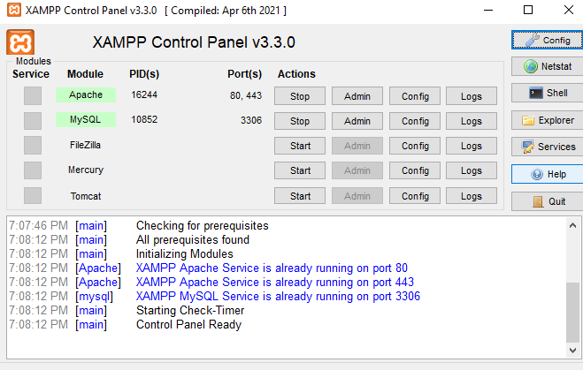

Slide 10
Open local development server
Open XAMPP control panel
Click start in front of Apache and Mysql
Then click admin or open browser and write 127.0.0.1 or localhost/yourWebsiteDirectory

Slide 11
Code editor
One of required tool is code editor and there are some options:
Notepad
Sublime Text
VS Code
PHPStorm

Slide 12



How PHP runs
PHP Interpreter
Client
Database

Slide 13
PHP
Easier to get started
Beginner friendly
Powerful
Build CLI tools
Build Websites and Web apps
E-commerce
Blog
Billing
Great ecosystems and frameworks
Countless third-part services

Slide 14
PHP Syntax
Standard
<?php // opening tag
/*
Body
*/
?> // closing tag
PHP opening and closing tags
If the file is php only closing tag is not mandatory. But, When PHP is embedded in HTML there must be proper opening and closing tags.

Slide 15
PHP Syntax
2. Short form
<? // opening tag
/*
Body
*/
?> // closing tag
if short_open_tag is enabled in php.ini it is possible to use it without php in the opening tag.

Slide 16
PHP Syntax
3. ASP
<% // opening tag
/*
Body
*/
%> // closing tag
It is possible to use <% as opening and %>

Slide 17
PHP Syntax
3. script
<script language=”php”> // opening tag
/*
Body
*/
</script> // closing tag
Using scrit sysntax

Slide 18
example
<?php
print( “Hello World”);
?>
1st create folder xampp/htdocs/ip2
2nd open text editor write this code
3rd save helloWorld.php in ip2
4th open browser and write 127.0.0.1/ip2
5th see Hello World

Slide 19
Send data to the browser
There are some options to send data to the browser:
Using echo : it is possible to send different types of data.
echo “Hello World” ; /// send string to the browser
echo 12; /// send integer to the browser
echo ‘Hello World’ ; //// send string to the browser which is in single quote
$name = “Almaz”;
echo $name; /// send data stored in a variable
echo ‘Hello’, ‘ ’,’World’;/// separet by coma

Slide 20
Send data to the browser
2 Using print : print is method will return true or false
Example
print( “Hello World”); /// send string to the browser
print( 12); /// send integer to the browser
print( ‘Hello World’); //// send string to the browser which is in single quote
$name = “Almaz”);
print( $name); /// send data stored in a variable

Slide 21
Send data to the browser
3 Using var_dump(): for testing. It will output data types, size and value
Example : var_dump( “Hello World”);
Output : string(11) "Hello World"
4. Using print_r(): if you want to print array echo couldn’t do it rather print_r() will do.
Example : var_dump( “Hello World”);
Output : string(11) "Hello World"

Slide 22
Variables
It is temporary storage
Naming convention
Always start by $ then followed by alphabet or underscore only the can be number
Cannot be $this: this is special variable used to reference and object
Assigned by value
Space is not allowed
Printing variable value: it could be in double quote or without quote or inclosed by {} in double quote but if it is not possible in single quote
$firstname = “Yared”;
echo “$firstname”; OR echo $firstname; OR echo “{$firstname}”;
Variable is cas sensitive. $name is different from $Name, $NAME, $namE,
Variable value can be override

Slide 23
Predefined Variables
Superglobals — Built-in variables that are always available in all scopes
$GLOBALS — References all variables available in global scope
$_SERVER — Server and execution environment information
$_GET — HTTP GET variables
$_POST — HTTP POST variables
$_FILES — HTTP File Upload variables
$_REQUEST — HTTP Request variables
$_SESSION — Session variables
$_ENV — Environment variables
$_COOKIE — HTTP Cookies
$php_errormsg — The previous error message
$http_response_header — HTTP response headers
$argc — The number of arguments passed to script
$argv — Array of arguments passed to script

Slide 24
Variable scope
Local: which is accessible only in a block of code only
Example:
function myTest() {
$x = 5; // local scope
echo "<p>Variable x inside function is: $x</p>";
}

Slide 25
Variable scope
Global: The global keyword is used to access a global variable from within a function.
$x = 5;
$y = 10;
function myTest() {
global $x, $y;
$y = $x + $y;
}
myTest();
echo $y; // outputs 15

Slide 26
Variable scope
Static: Normally, when a function is completed/executed, all of its variables are deleted. However, sometimes we want a local variable NOT to be deleted. We need it for a further job. To do this, use the static keyword when you first declare the variable: Example
function myTest() {
static $x = 0;
echo $x;
$x++;
}
myTest();
echo "<br>";
myTest();
echo "<br>";
myTest();
Output
0
1
2

Slide 27
Constant
Constants are like variables, except that once they are defined they cannot be changed or undefined.
A constant is an identifier (name) for a simple value.
The value cannot be changed during the script.
A valid constant name starts with a letter or underscore (no $ sign before the constant name).
Unlike variables, constants are automatically global across the entire script.

Slide 28
Constant can be defined by:
Using define method
define(“STATUS”, “paid”);
echo “Payment status “ .STATUS; // no need of $
Using const keyword
const PI = 3.14;
echo “Value of PI “.PI;
Output
Payment status paid
Output
Value of PI 3.14

Slide 29
Predefined/magic constant
In PHP, predefined constants are built-in constants provided by the language or by extensions that are automatically available in your scripts without needing to define them manually. These constants often provide useful information about the environment, configuration, and error handling
PHP_VERSION
PHP_OS
PHP_INT_MAX
PHP_INT_MIN
__LINE__
E_ERROR
Example
echo "PHP version " .PHP_VERSION;
Output
PHP version 8.2.17

Slide 30
Variable variable
It mean take the value of variable and treat as name.
Example:
$foo = ‘bar’;
$$foo =’baz’; // $foo is bar then $bar is variable for baz
echo $foo, ‘ ‘, $bar;
Output : bar baz

Slide 31
Embedding PHP in HTML
<!DOCTYPE html>
<html lang="en">
<head>
<title>Internet Programming Two</title>
</head>
<body>
<?php echo “<h1> Hello World </h1>”;?>
<h1><?= “Hello World” ?></h1>
</body>
</html>

Slide 32
Embedding PHP in HTML
<!DOCTYPE html>
<html lang="en">
<body>
<?php
$x = 4;
$y = 5;
?>
<p> echo $x.” + “. $y. “ = “.($x +$y)</p>
</body>
</html>

Slide 33
Comments
It is a line that is not executed as a part of the program.
Its only purpose is to be read by someone who is looking at the code.
Let others understand your code
Remind yourself of what you did
Single line comment
Use // at the beginning of the line
Use # at the beginning of the line
Multi-line comment
/*
Body
*/

Slide 34
Data types
PHP is loosely typing and dynamically typing language this means not require to write type of variable when define and also the type can be change after defined.
Dynamically typing mean type checking happens at run time while statically typed language means type checking happens at compile time.
So, php is flexible. however , it is also strictly type in latest version.
PHP supports ten primitive types which are grouped by four scalar types, four compound types and two special types

Slide 35
Cont….
Four scalar types
Bool
Int
Float
String
Four compound types
Array
Object
Callable
Iterable
Special types
Resource
Nul

Slide 36
Booleans
The bool type only has two values, and is used to express a truth value. It can be either true or false.
To specify a bool literal, use the constants true or false. Both are case-insensitive.
<?php
$foo = True; // assign the value TRUE to $foo
?>

Slide 37
Integers
An int is a number of the set ℤ = {..., -2, -1, 0, 1, 2, ...}. Whole number
Ints can be specified in decimal (base 10), hexadecimal (base 16), octal (base 8) or binary (base 2) notation.
The negation operator can be used to denote a negative int.
To use octal notation, precede the number with a 0 (zero).
As of PHP 8.1.0, octal notation can also be preceded with 0o or 0O.
To use hexadecimal notation precede the number with 0x.
To use binary notation precede the number with 0b.
As of PHP 7.4.0, integer literals may contain underscores (_) between digits, for better readability of literals. These underscores are removed by PHP's scanner.

Slide 38
Integer Example
<?php
$a = 1234; // decimal number
$a = 0123; // octal number (equivalent to 83 decimal)
$a = 0o123; // octal number (as of PHP 8.1.0)
$a = 0x1A; // hexadecimal number (equivalent to 26 decimal)
$a = 0b11111111; // binary number (equivalent to 255 decimal)
$a = 1_234_567; // decimal number (as of PHP 7.4.0)
?>

Slide 39
Floating point numbers
Floating point numbers (also known as "floats", "doubles", or "real numbers") can be specified using any of the following syntaxes:
<?php
$a = 1.234;
$b = 1.2e3;
$c = 7E-10;
$d = 1_234.567; // as of PHP 7.4.0
?>

Slide 40
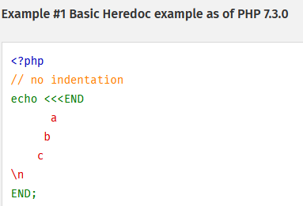
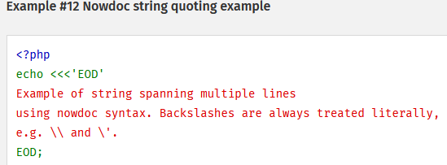
Strings
A string is a series of characters, where a character is the same as a byte.
This means that PHP only supports a 256-character set, and hence does not offer native Unicode support.
A string literal can be specified in four different ways:
single quoted : $name =’Yared’;
double quoted : $name =”Yared”;
heredoc syntax:
nowdoc syntax

Slide 41
var_dump()
<?php
$b = 3.1;
$c = true;
var_dump($b, $c);
?>
Output
float(3.1)
bool(true)

Slide 42
gettype()
<?php
$b = 3.1;
$c = true;
echo gettype($b);
?>
Output
double

Slide 43
Arrays
An array in PHP is actually an ordered map.
A map is a type that associates values to keys.
This type is optimized for several different uses;
it can be treated as an
array,
list (vector),
hash table (an implementation of a map),
dictionary,
Collection,
stack,
queue, and probably more.
As array values can be other arrays, trees and multidimensional arrays are also possible.

Slide 44
Array definition/initialization
<?php
$array = array( "foo" => "bar", "bar" => "foo",);
// Using the short array syntax
$array = [ "foo" => "bar", "bar" => "foo"];
?>

Slide 45
Resources
A resource is a special variable, holding a reference to an external resource. Resources are created and used by special functions.
Example database conection
$conn = mysqli_connect(“localhost”,”root”,””);

Slide 46
NULL
The null type is PHP's unit type, i.e. it has only one value: null.
Undefined, and unset() variables will resolve to the value null.
<?php
$var = NULL;
?>

Slide 47
Casting
Casting to integer
Casting to null
Casting to boolean
Casting to float
Casting to string

Slide 48
Casting to Integer using (int) or (integer)
From booleans
false will yield 0 (zero), and true will yield 1 (one).
$isValid = (int) true;//will be 1
From floating point numbers
When converting from float to int, the number will be rounded towards zero.
As of PHP 8.1.0, a deprecation notice is emitted when implicitly converting a non-integral float to int which loses precision.
$x = (integer)9.7;// will be 9
From strings
If the string is numeric or leading numeric then it will resolve to the corresponding integer value, otherwise it is converted to zero (0).
$name = (int)“78Yared”;// will be 78
From NULL
null is always converted to zero (0).
$t = (int) null;// will be 0

Slide 49
2. Casting to null
This feature has been DEPRECATED as of PHP 7.2.0, and REMOVED as of PHP 8.0.0. Relying on this feature is highly discouraged.
Casting a variable to null using (unset) $var will not remove the variable or unset its value.
It will only return a null value.

Slide 50
3. Casting to boolean
When converting to bool, the following values are considered false:
the boolean false itself
the integer 0 (zero)
the floats 0.0 and -0.0 (zero)
the empty string "", and the string "0"
an array with zero elements
the unit type NULL (including unset variables)
Internal objects that overload their casting behaviour to bool. For example: SimpleXML objects created from empty elements without attributes.
Every other value is considered true (including resource and NAN).

Slide 51
Example of casting to boolean
<?php
var_dump((bool) ""); // bool(false)
var_dump((bool) "0"); // bool(false)
var_dump((bool) 1); // bool(true)
var_dump((bool) -2); // bool(true)
var_dump((bool) "foo"); // bool(true)
var_dump((bool) 2.3e5); // bool(true)
var_dump((bool) array(12)); // bool(true)
var_dump((bool) array()); // bool(false)
var_dump((bool) "false"); // bool(true)
?>

Slide 52
4. Casting to float
From strings
If the string is numeric or leading numeric then it will resolve to the corresponding float value, otherwise it is converted to zero (0).
From other types
For values of other types, the conversion is performed by converting the value to int first and then to float.

Slide 53
5. Casting to string
A value can be converted to a string using the (string) cast or the strval() function.
String conversion is automatically done in the scope of an expression where a string is needed.
This happens when using the echo or print functions, or when a variable is compared to a string.
A bool true value is converted to the string "1".
bool false is converted to "" (the empty string).
An int or float is converted to a string representing the number textually (including the exponent part for floats).

Slide 54
cont…
Arrays are always converted to the string "Array"
In order to convert objects to string, the magic method __toString must be used.
Resources are always converted to strings with the structure "Resource id #1", where 1 is the resource number assigned to the resource by PHP at runtime.
null is always converted to an empty string.

Slide 55
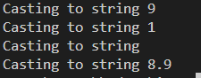
Examples of casting to string
$x = 9;
$y = true;
$z = null;
$f = 8.9;
echo "Casting to string ".(string)$x."\n";
echo "Casting to string ".(string)$y."\n";
echo "Casting to string ".(string)$z."\n";
echo "Casting to string ".(string)$f."\n";

Slide 56
Operators
Arithmetic
Increment and Decrement
Assignment
Bitwise
Comparison
Error Control
Execution
Logic
String
Array
Type
An operator is something that takes one or more values (or expressions, in programming jargon) and yields another value (so that the construction itself becomes an expression).

Slide 57
Cont…
Operators can be grouped according to the number of values they take.
Unary operators take only one value, for example ! (the logical not operator) or ++ (the increment operator).
Binary operators take two values, such as the familiar arithmetical operators + (plus) and - (minus), and the majority of PHP operators fall into this category.
Finally, there is a single ternary operator, ? :, which takes three values; this is usually referred to simply as "the ternary operator" (although it could perhaps more properly be called the conditional operator).

Slide 58
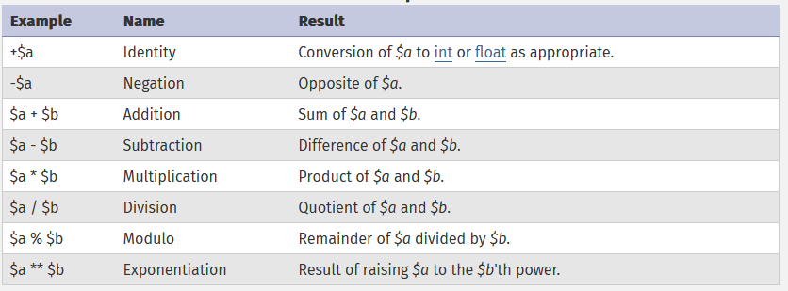
Arithmetic Operator

Slide 59
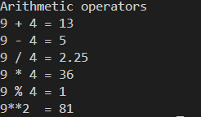
Arithmetic operators example
$x = 9;
$y = 4;
echo "Arithmetic operators \n";
echo "$x + $y = ".($x + $y)."\n";
echo "$x - $y = ".($x - $y)."\n";
echo "$x / $y = ".($x / $y)."\n";
echo "$x * $y = ".($x * $y)."\n";
echo "$x % $y = ".($x % $y)."\n";
echo "$x**2 = ".($x**2)."\n";

Slide 60
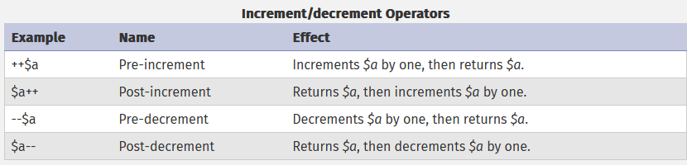
2. Increment/Decrement operators

Slide 61
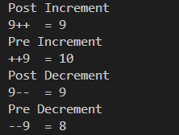
Increment/Decrement operators example
$x = 9;
echo "Post Increment \n";
echo "$x++ = ".($x++)."\n";
$x = 9;
echo "Pre Increment \n";
echo "++$x = ".(++$x)."\n";
$x = 9;
echo "Post Decrement \n";
echo "$x-- = ".($x--)."\n";
$x = 9;
echo "Pre Decrement \n";
echo "--$x = ".(--$x)."\n";

Slide 62
3. Assignment operator
The basic assignment operator is "=".
The value of an assignment expression is the value assigned. That is, the value of "$a = 3" is 3.
<?php
$a = 3;
$a += 5; // sets $a to 8, as if we had said: $a = $a + 5;
$b = "Hello ";
$b .= "There!"; // sets $b to "Hello There!", just like $b = $b . "There!";
?>

Slide 63
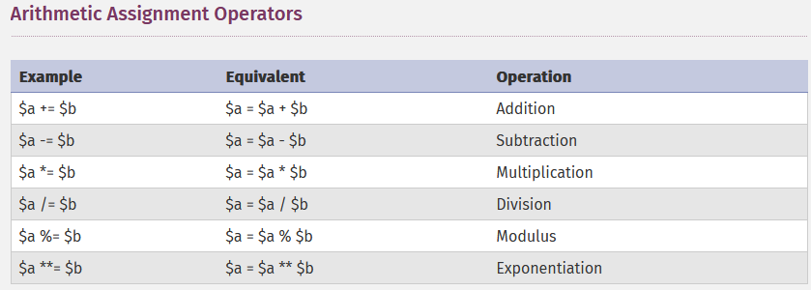

Slide 64
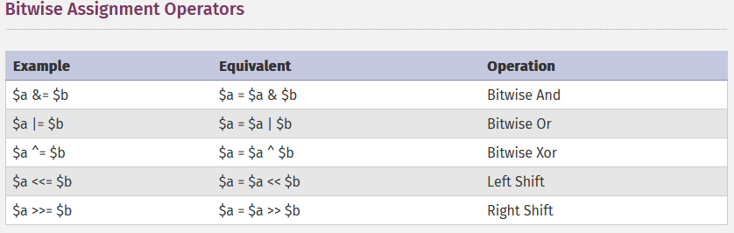

Slide 65
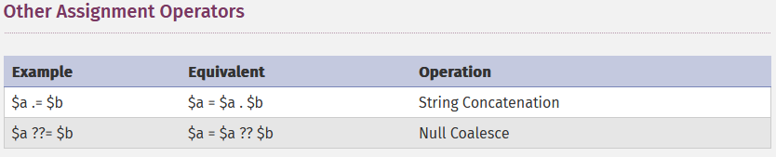

Slide 66
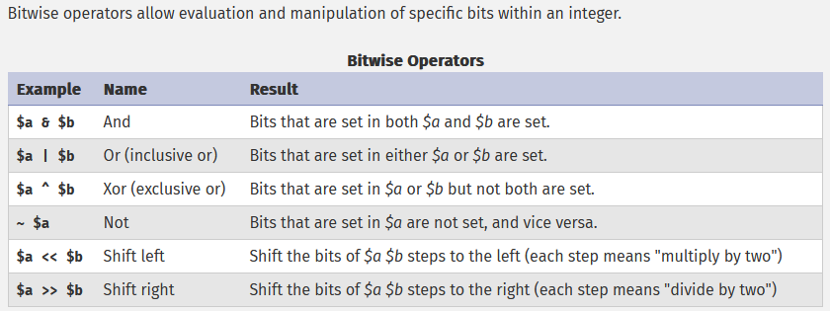
4. Bitwise operators

Slide 67
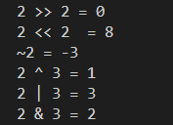
Bitwise operators examples
$x = 2;//10
$y = 3;//11
echo "$x >> 2 = ".($x>>2)."\n";//10>>2 = 0001
echo "$x << 2 = ".($x<<2)."\n";//10 << 2 = 1000
echo "~$x = ".(~$x)."\n";//~10 = 01
echo "$x ^ $y = ".($x^$y)."\n";//10 ^ 11 = 01
echo "$x | $y = ".($x | $y)."\n";//10 | 11 = 11
echo "$x & $y = ".($x & $y)."\n";//10 & 11 = 10

Slide 68
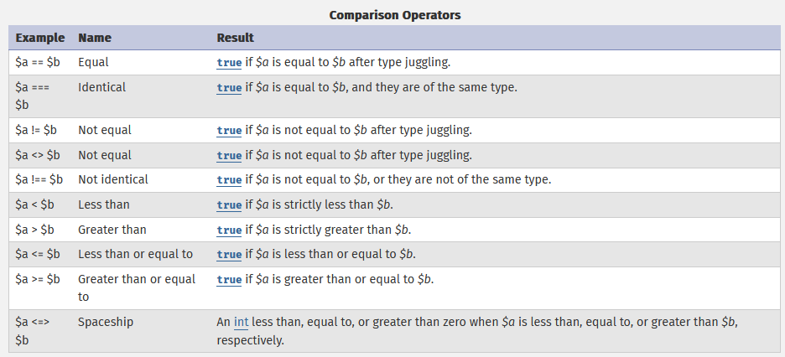
5. Comparison/Relational Operators

Slide 69
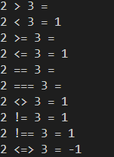
Comparison/relational operators
$x = 2;
$y = 3;
echo "$x > $y = ".($x > $y)."\n";
echo "$x < $y = ".($x < $y)."\n";
echo "$x >= $y = ".($x >= $y)."\n";
echo "$x <= $y = ".($x <= $y)."\n";
echo "$x == $y = ".($x == $y)."\n";
echo "$x === $y = ".($x === $y)."\n";
echo "$x <> $y = ".($x <> $y)."\n";
echo "$x != $y = ".($x != $y)."\n";
echo "$x !== $y = ".($x !== $y)."\n";
echo "$x <=> $y = ".($x <=> $y)."\n";

Slide 70
6. Error control operator
PHP supports one error control operator: the at sign (@).
When prepended to an expression in PHP, any diagnostic error that might be generated by that expression will be suppressed.
echo $x;
PHP Warning: Undefined variable $x in C:\xampp\htdocs\ip2\test.php on line 3
echo @$x;
No PHP Warning

Slide 71
7. Execution Operators
PHP supports one execution operator: backticks (``).
Note that these are not single-quotes! PHP will attempt to execute the contents of the backticks as a shell command; the output will be returned (i.e., it won't simply be dumped to output; it can be assigned to a variable).
Use of the backtick operator is identical to shell_exec().
<?php
$output = `ls -al`;
echo "<pre>$output</pre>";
?>

Slide 72
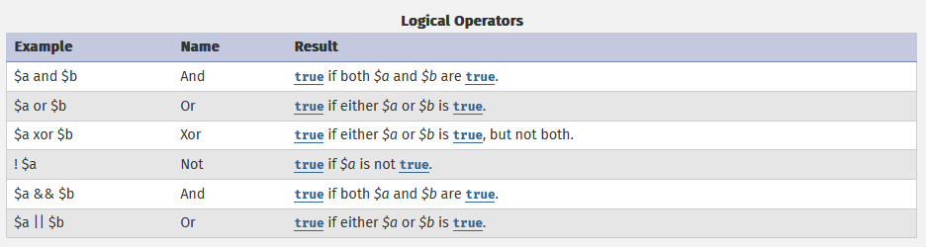
8. Logic operators

Slide 73
Logical operators example
$x = true;
$y = false;
echo '$x && $y = '. var_dump($x && $y)."\n"; // false
echo '$x and $y = '. var_dump($x and $y)."\n"; //false
echo '$x || $y = '. var_dump($x || $y)."\n"; //true
echo '$x or $y = '. var_dump($x or $y)."\n";//true
echo '!$x = '. var_dump(!$x)."\n";//false
echo '$x xor $y = '. var_dump($x xor $y)."\n";//true

Slide 74
9. String operators and functions
There are two string operators.
The first is the concatenation operator ('.'), which returns the concatenation of its right and left arguments.
The second is the concatenating assignment operator ('.='), which appends the argument on the right side to the argument on the left side.
<?php
$a = "Hello ";
$b = $a . "World!"; // now $b contains "Hello World!"
$a = "Hello ";
$a .= "World!"; // now $a contains "Hello World!"
?>

Slide 75
String functions: some of them
$hello = "Hello";
echo "To upper case ".strtoupper($hello)."\n";
echo "To lower case ".strtolower($hello)."\n";
echo "Number of character ".strlen($hello)."\n";
echo "Check o availability in hello ".str_contains($hello,"o")."\n";
$hello = " Hello ";
echo "trim ".trim($hello)."\n";
$detail = <<<END
My name is Abebe Kebede
I'm <b>23</b> years old
I'm from <em>Ethiopia</em>
\n
END;
echo $detail;
echo htmlentities($detail);

Slide 76
10. Array operators
Indexed array
Create an Array
$books = [“PHP”,”HTML”, “CSS”];
$books = array(“PHP” “HTML”, “CSS”);
$books = [“one” => “PHP”, “two” => “HTML”, “three” =>”CSS”];
$books = []; // empty array
$books = array(); //empty array

Slide 77
10. Array operators
2. Access an Array elements
$books = [“PHP”,”HTML”, “CSS”];//
echo “The first book “. $books[0]; echo “The last book “.$books[2];
$books = array(“PHP” “HTML”, “CSS”);
echo “The first book “. $books[0]; echo “The last book “.$books[2];
$books = [“one” => “PHP”, “two” => “HTML”, “three” =>”CSS”];
echo “The first book “. $books[“one]; echo “The last book “.$books[“three];

Slide 78
10. Array operators
3. Add an Array elements
$books = [“PHP”,”HTML”, “CSS”];
$books[] = “MySql”;
$books = array(“PHP” “HTML”, “CSS”);
$books[] = “Java”;
$books = [“one” => “PHP”, “two” => “HTML”, “three” =>”CSS”];
$books = [“one” => “PHP”, “two” => “HTML”, “three” =>”CSS”,”four” =>”Java];

Slide 79
10. Array operators
4. Replace an Array elements
$books = [“PHP”,”HTML”, “CSS”];
$books[1] = “MySql”;
$books = array(“PHP” “HTML”, “CSS”);
$books[0] = “Java”;
$books = [“one” => “PHP”, “two” => “HTML”, “three” =>”CSS”];
$books = [“one” => “Java”];

Slide 80
10. Array operators
5. Remove an Array elements
$books = [“PHP”,”HTML”, “CSS”];
array_splice($books,1,1);
$books = array(“PHP” “HTML”, “CSS”);
unset($books[2]);
$books = [“one” => “PHP”, “two” => “HTML”, “three” =>”CSS”];
unset($books[“one”]);

Slide 81
Multidimensional array/Array of arrays
$books = [
["title"=>"PHP", "autor"=>"Ramson Lordof", "publishedYear"=>1990,
"price"=>150 ],
[ "title"=>"HTML", "autor"=>"Team Bernel lee", "publishedYear"=>1940,
"price"=>200 ],
[ "title"=>"CSS","autor"=>"Ramson Lordof", "publishedYear"=>2000,
"price"=>90 ]
];

Slide 82
Access multidimensional array elements
<?php for($i = 0; $i < count($books); $i++):?>
<p>Title : <?php echo $books[$i]['title']?></p>
<p>Autor: <?php echo $books[$i]['autor']?></p>
<p>Published year : <?php echo $books[$i]['publishedYear']?></p>
<p>Price :<?php echo $books[$i]['price']?></p>
<?php endfor;?>

Slide 83
Thanks

